Slide 1
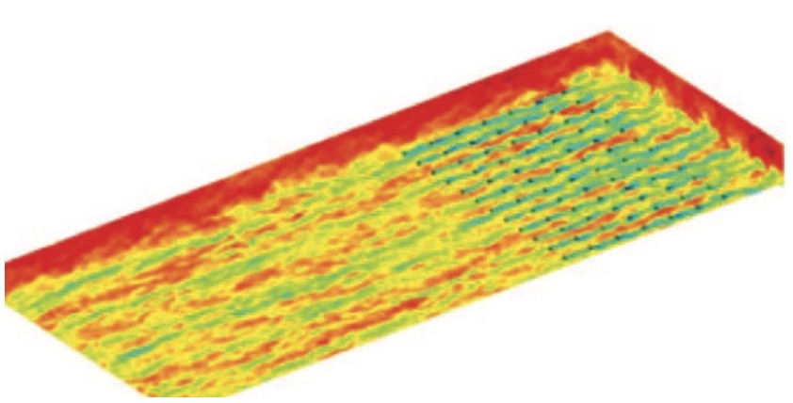
Goal 1:
Develop generative surrogate model
Goal 2: Incorporate physical constraints
Predict
spatio-temporal
wind field
Explicitly add constraints during training and prediction
Implicitly learn prior knowledge of wake turbulence
Goal 2: Incorporate multi-source measurements
Integrate measurements into predictions without retraining

Slide 2
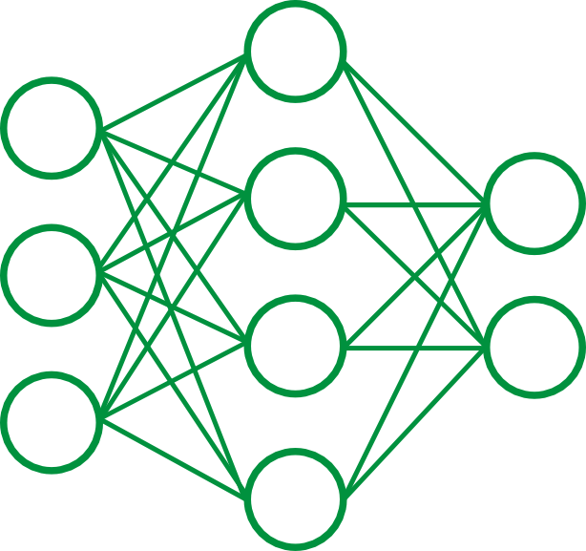
Pretrain
Encoder
Latent representation
Decoder
Spatio-temporal
wake turbulence
Spatio-temporal
wake turbulence

Slide 3


Encoder
Add noise step by step
Spatio-temporal
wind field
Decoder
Conditional generation by denoising step by step using neural network
Gaussian
noise
WP2a
WP2b
Representations of multi-source data as conditions

Slide 4
Physical space
Training in latent space
Training dataset
Add noise step by step
Encoder
Conditional generation by denoising gradually using a neural network
Decoder
Spatio-temporal
wind field
Gaussian
noise
Representations of multi-source data as conditions
WP2a
WP2b

Slide 5
(a)
Offline: Pretrain
Encoder
Decoder
Add noise
WP2a
Denoise gradually using a neural network
WP1 Training dataset
WP2b multi-source information & WP3a physical constraints
Gaussian noise
(b)
Online: Prediction
WP2b multi-source information WP3a physical constraints
WP3b new
measurements
Prediction
WP2a
Decoder
WP4 test and evaluate
Conditional generation using a neural network
Spatio-temporal
wind field
Gaussian noise

Slide 6
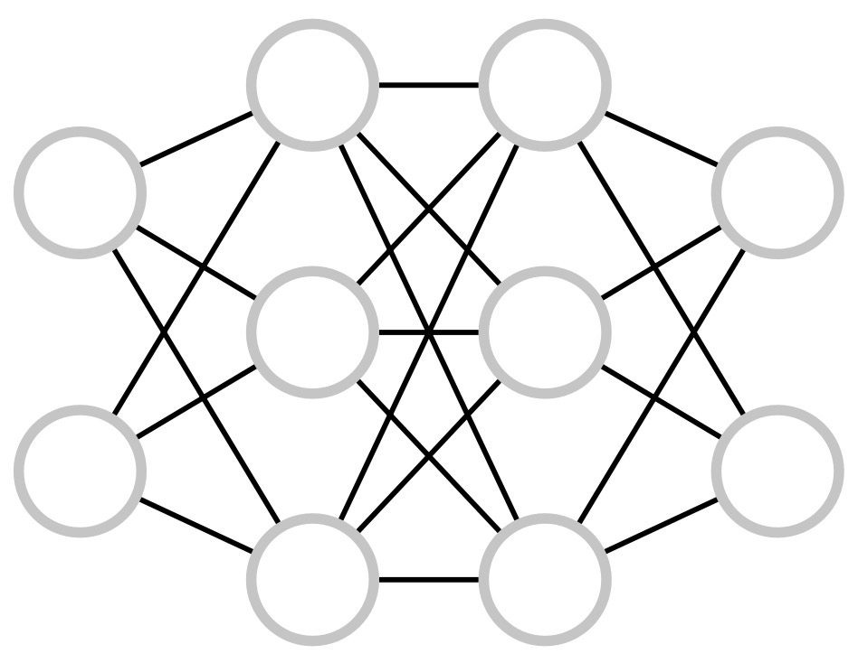

(a)
Offline: Pretrain
Input: Multi-source information
Physical constraints
WP1
Spatio-temporal samples of wind field
WP2b
WP3a
Training
WP2a
Decoder
Gaussian
noise
Add noise
WP2a
Encoder
(b)
Online: Prediction
Physical constraints
Pretrained model
Gaussian
noise
Incorporate measurements
WP3a
Spatio-temporal sample of wind field
WP3b
Decoder
WP2a
Input:
Multi-source information
WP2b
WP2b
Multi-source measurements

Slide 7
(a)
Offline: Pretrain
(b)
Online: Prediction
Spatio-temporal samples of wind field
WP3b: Measurements
Prediction of spatio-temporal wind field
Add noise
WP2a: Decoder
Pretrained model
Denoise
WP1
Gaussian
noise
WP2b: Multi-source information
WP3a: Physical constraint
WP2b: Multi-source information
WP3a: Physical constraint

Slide 8
(a) Offline: Pretrain
(b) Online: Prediction
New multi-source
measurements
Input:
Multi-source
information
Conditional
diffusion model
Output:
Wind field
Input:
Multi-source
information
Conditional
diffusion model
Output:
Wind field
⨁
Physical Constraints
Physical Constraints

Slide 9
(a) Offline: Pretrain
(b) Online: Prediction
New multi-source
measurements
Input:
Multi-source
information
Conditional
diffusion model
Output:
Wind field
Input:
Multi-source
information
Conditional
diffusion model
Output:
Wind field
Physical Constraints
Physical Constraints

Slide 10
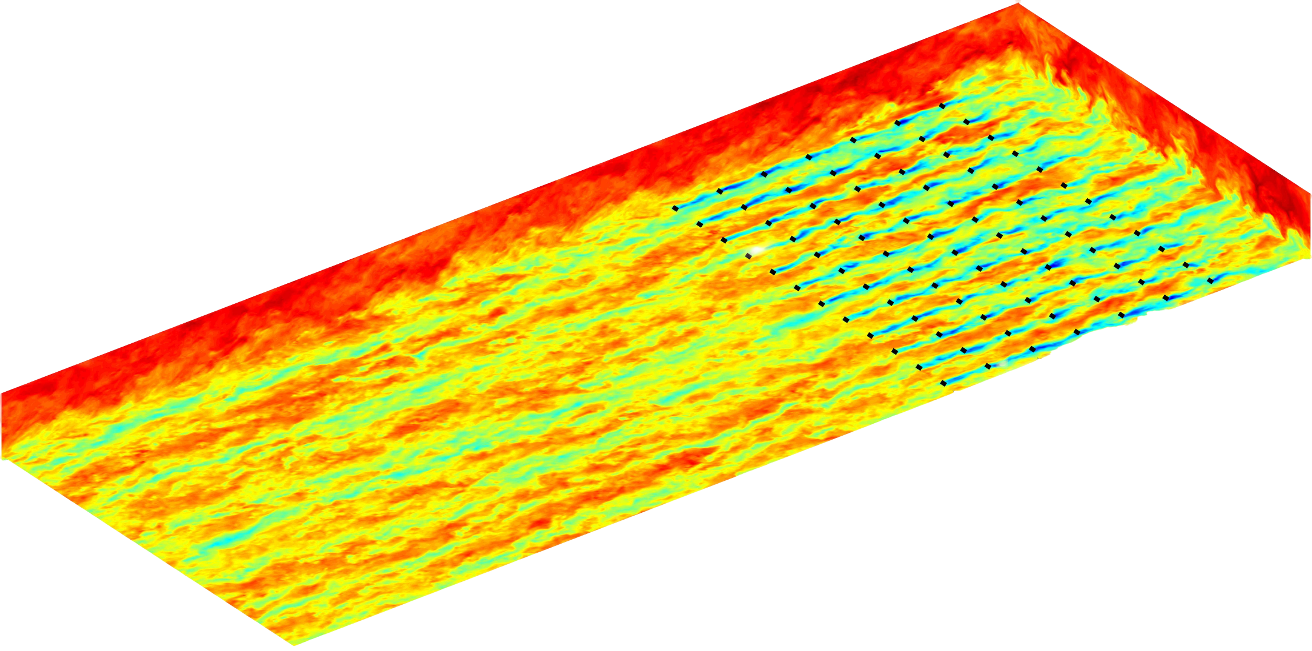
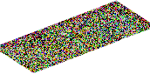
(a) Offline: Pretrain
(b) Online: Prediction
Spatio-temporal samples of wind field
Multi-source information
Physical constraints
Gaussian
noise
Multi-source information
Physical constraints
Prediction of spatio-temporal wind field
Decoder: Denoising
Decoder:
Pretrained
model
Encoder: Add noise
WP1
WP2
WP3
Multi-source measurements
WP4

Slide 11
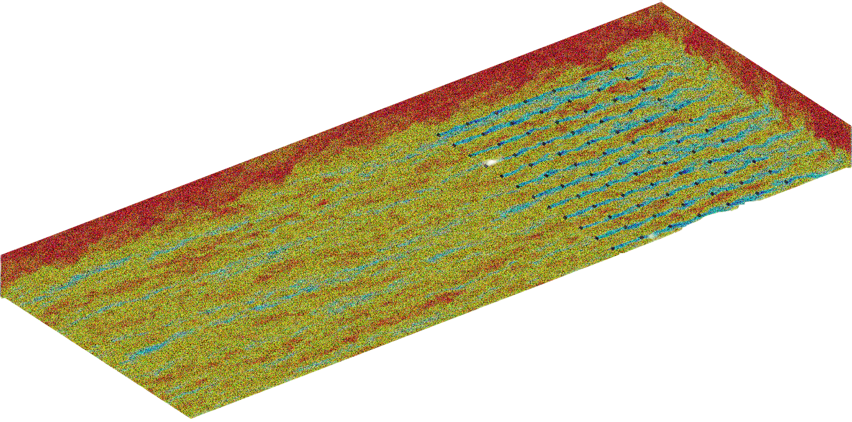
Encoder
add noise
WP2b
Representations of multi-source data
WP2a
Generative surrogate model
Condition
Input
wind field
Output
wind field
Encoder
Add noise
Gaussian Noise
Denoise
Decoder

Slide 12

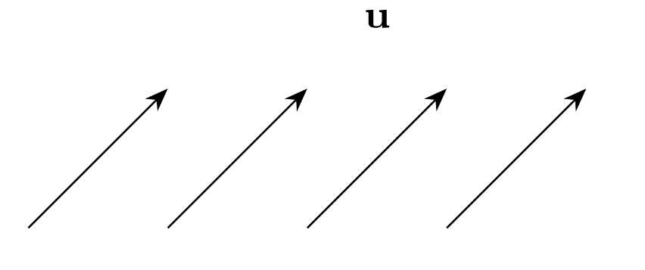
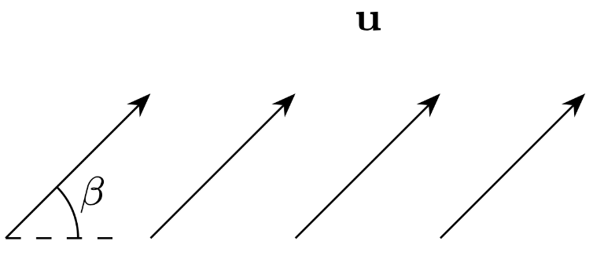
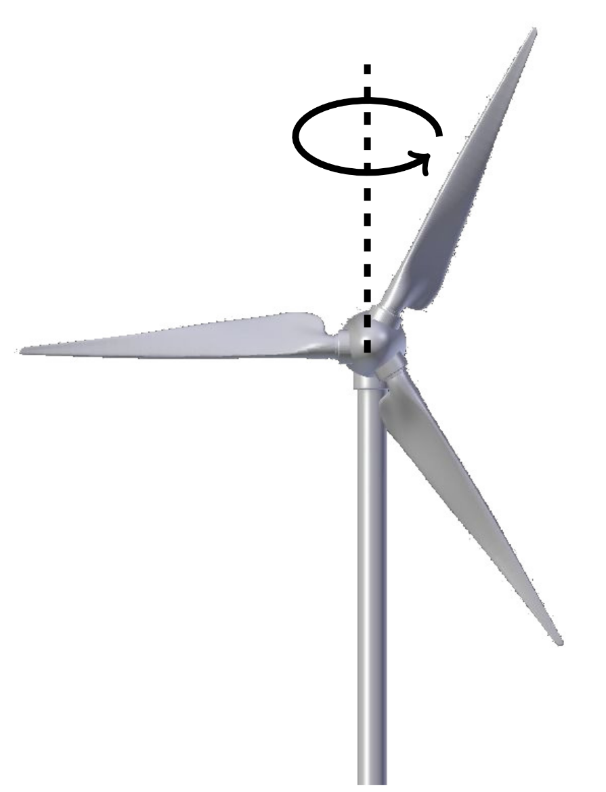
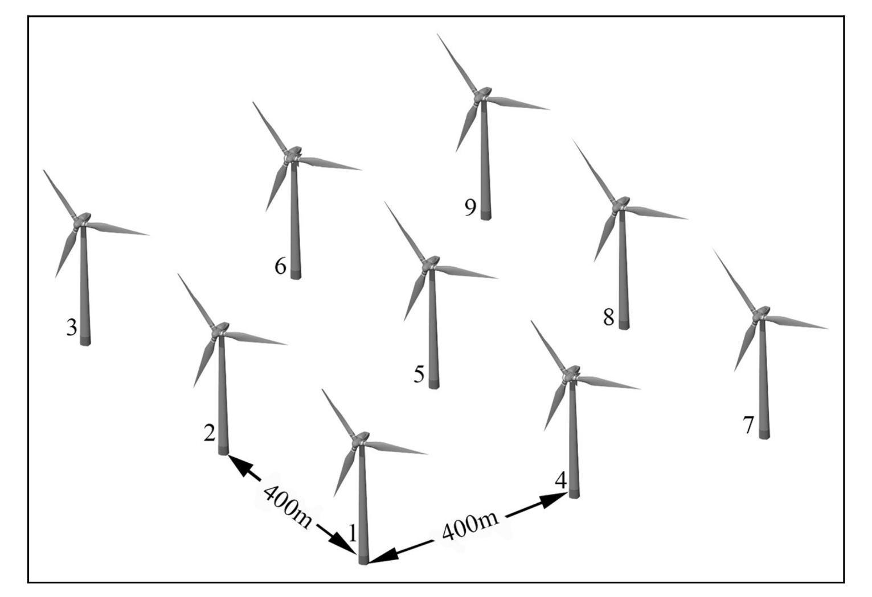
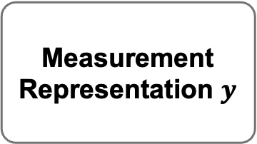
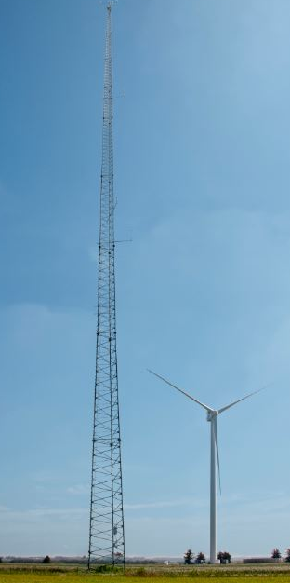
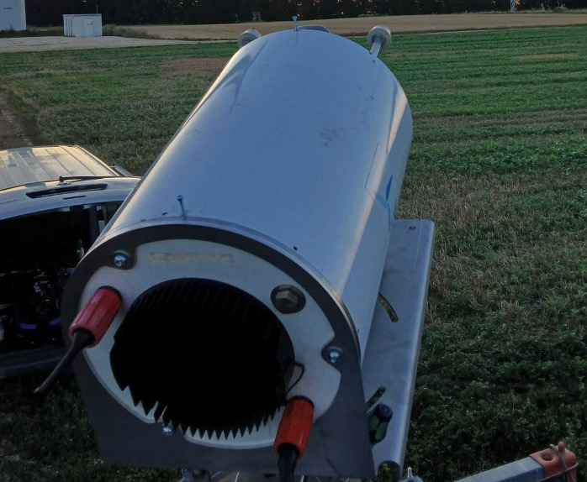
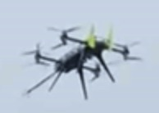
(a)
Multi-Source Information Data
Wind speed
Wind angle
Yaw angle
Turbine
layout
Embedding
(b)
Multi-Source Measurement Data
MetMasts
LiDAR
UAVs
Embedding

Slide 13
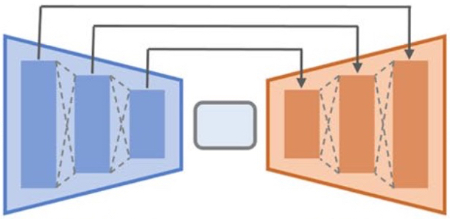
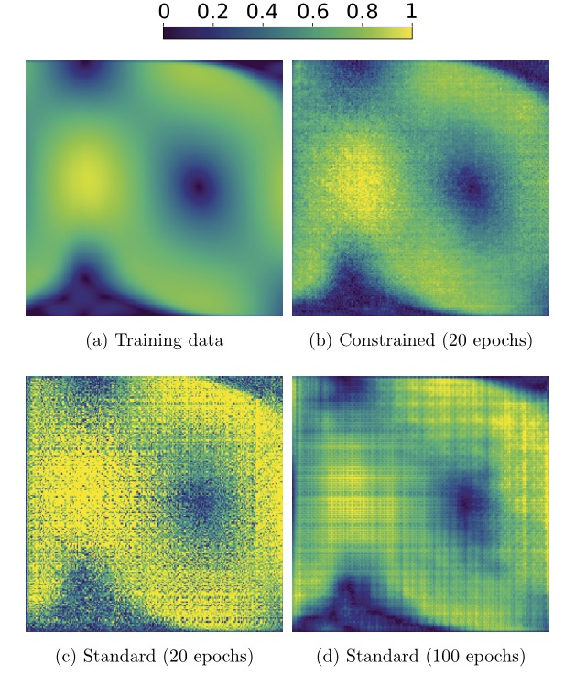
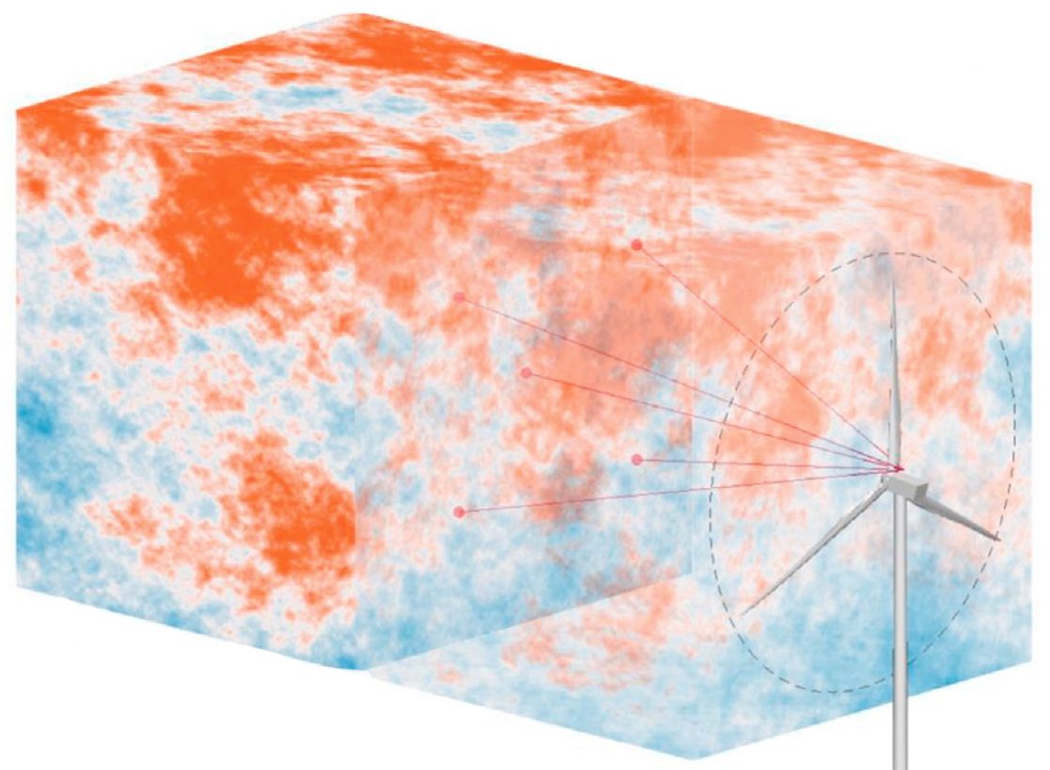
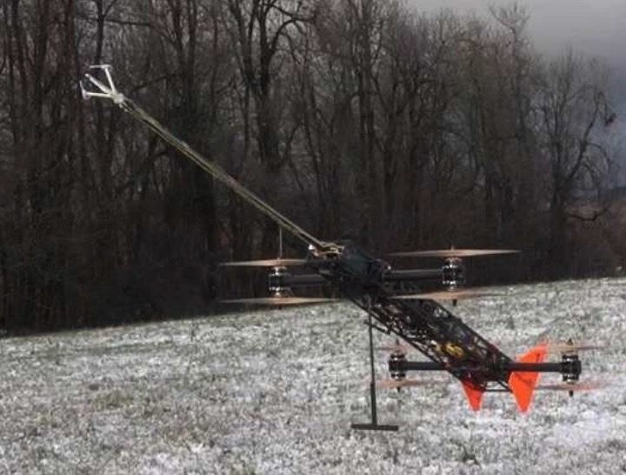

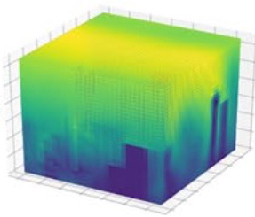
Physics-guided surrogate modeling
Multi-source wind farm measurements
(b)
Ground truth
(c)
(d)
With constraints
No constraints

